Slide 1





Algorithm Trading
Team : Name & Email id Guide: P.Raja, Master Trainer
B.Sasil Betra & samsam13057@Gmail.com
Disclaimer: The content is curated for educational purposes only.
Notes:
Slides: Prepare a short slide deck (10-12 slides) summarizing the project objectives, methodology, and key results.

Slide 2
OUTLINE
Abstract of the Project
Problem Statement
Proposed Solution
System Architecture
Embedded Video of Project
Conclusion
Future Scope

Slide 3
Abstract
The rapid advancements in artificial intelligence (AI) have revolutionized various sectors, including finance. This paper explores the implementation of AI-based trading algorithms designed to analyze complex market data, identify trends, and execute automated trading decisions. The primary goal is to enhance investment strategies and maximize returns by leveraging machine learning and deep learning techniques. The methodology includes data collection from reliable financial sources, feature engineering to derive predictive signals, and the use of models such as Recurrent Neural Networks (RNNs) for time series forecasting and Reinforcement Learning (RL) for adaptive strategies.

Slide 4
Problem Statement
In the highly volatile and complex financial markets, making timely and accurate trading decisions is critical for optimizing investment returns. Traditional trading strategies often rely on manual analysis or static rules-based systems that may not effectively adapt to rapidly changing market conditions. This limitation leads to suboptimal performance and increased risk exposure for traders and investors. The challenge lies in developing a robust system that can process large volumes of market data, identify meaningful patterns, and make automated, data-driven trading decisions in real-time. The objective is to leverage artificial intelligence, specifically machine learning and deep learning models, to build an adaptive algorithmic trading framework.

Slide 5
Proposed Solution
This proposed solution aims to enhance a ChatGPT-based AI chatbot by improving its contextual understanding, domain expertise, ethical standards, and user privacy. By implementing memory systems, fine-tuning for specific industries, addressing biases, ensuring data security, and supporting multimodal interactions, this solution would significantly enhance the chatbot's capabilities, making it more reliable, personalized, and suitable for a wide range of applications. Continuous learning and transparency would further build user trust, while human-in-the-loop systems provide an extra layer of oversight for critical applications.

Slide 6
System Architecture
This architecture ensures a comprehensive approach to developing and deploying AI-based trading algorithms, providing robust data handling, accurate predictions, reliable execution, and comprehensive risk management to optimize trading strategies effectively.
1. Data Layer
2. Model Training Layer.
3. Backtesting and Simulation Layer.
4. Execution Layer
5. Monitoring and Risk Management Layer

Slide 7
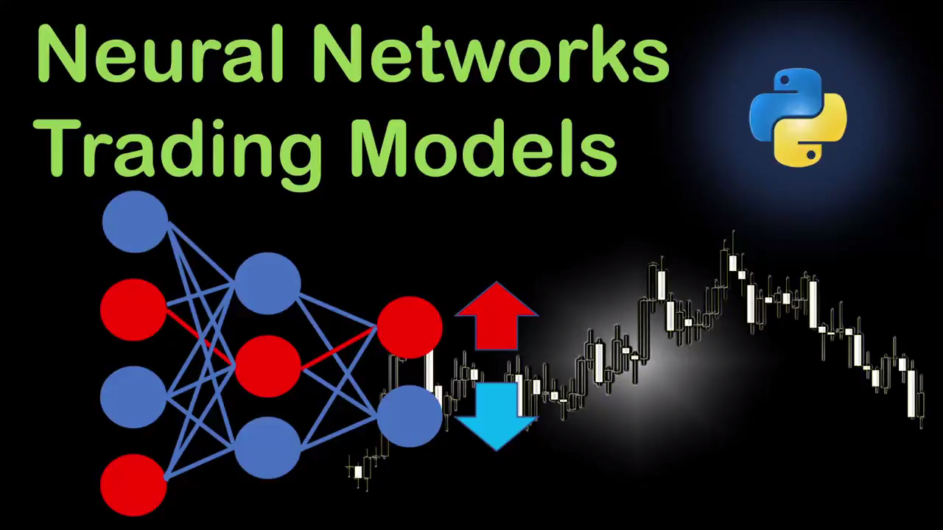
Video of Project Demo

Slide 8
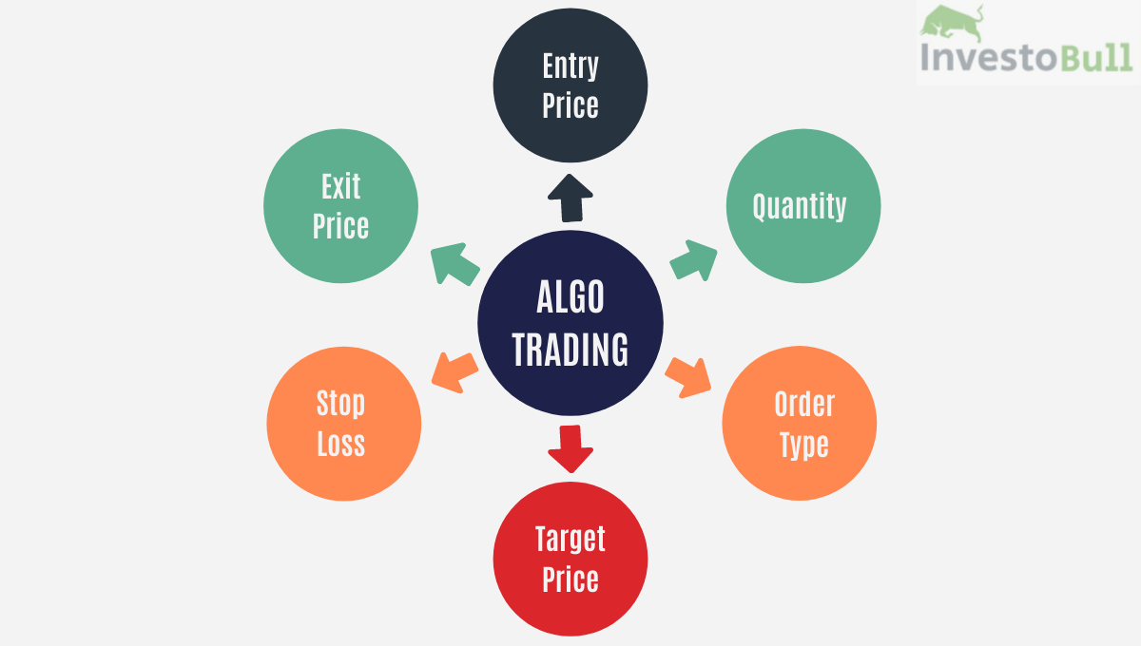
Future Scope

Slide 9
Conclusion
In conclusion, implementing AI-based trading algorithms can significantly enhance the effectiveness of investment strategies by leveraging data-driven insights and automating decision-making processes. The development process involves careful data collection, model selection, rigorous backtesting, and strategic risk management to ensure robustness and reliability. By continuously retraining models and incorporating feedback loops, traders can adapt to changing market conditions and maintain a competitive edge. Utilizing the right technological stack and tools further supports scalability and execution efficiency. When executed thoughtfully, AI-based trading systems have the potential to optimize investment returns while mitigating risks, making them an invaluable tool for modern trading.

Slide 10
Thank you!
Notes:
thank you very much for joining this PPT, keep learning.
10

